Slide 1

Chapter 15
Planning Public Speaking

Slide 2
An Enlarged Conversation
Consider others’ perspectives
Adapt to the situation
Express ideas clearly
Organize what we say
Explain and support our ideas
Present in an engaging manner

Slide 3
Choosing Your Topic
Select a topic that matters to you
Select a topic appropriate to the speaking occasion
Select a topic appropriate to your audience
Narrow your topic
Mind map

Slide 4
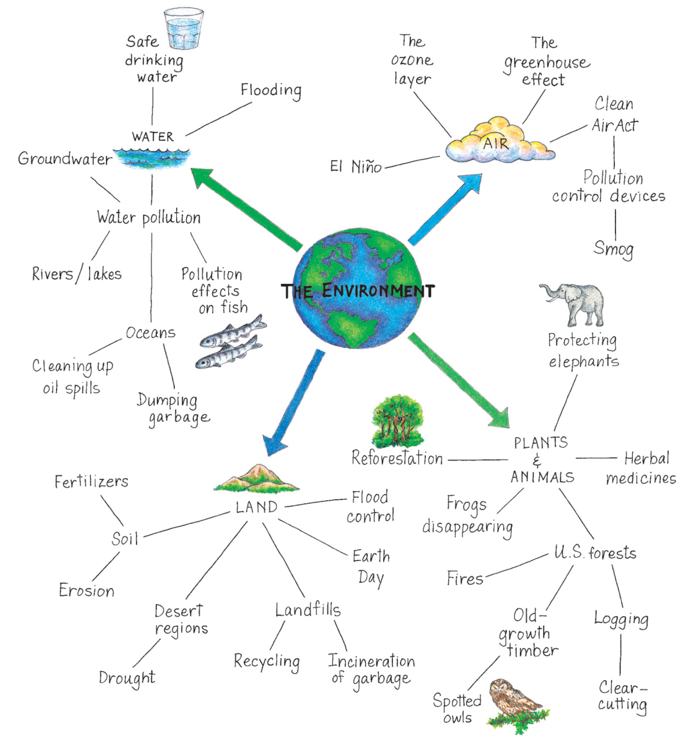
Mind Map
Cengage Learning

Slide 5
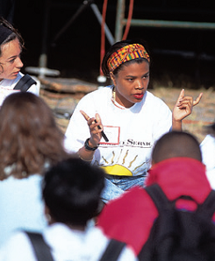
General Purposes of Speaking
Speeches to inform
Increase understanding, awareness, and knowledge
Speeches to persuade
Change attitudes, beliefs, behaviors, or motivate to action
Speeches to entertain
Interest, amuse, or please listeners
Humor
Storytelling
Mark Richards/PhotoEdit

Slide 6
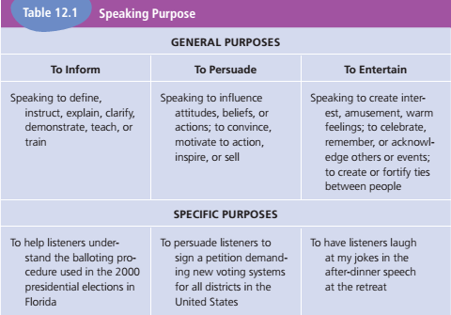
General Purposes of Speaking (cont’d)
Cengage Learning

Slide 7
Specific Purpose
A behavioral objective or observable response that indicates you have achieved your communication goal
“I want to convince my listeners that current gun control policies negatively impact individuals.”
“I want my audience to understand the screen printing process.”

Slide 8
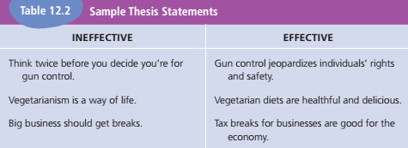
Thesis Statement
Main idea of an entire speech
Short, precise
Easily remembered
Cengage Learning

Slide 9
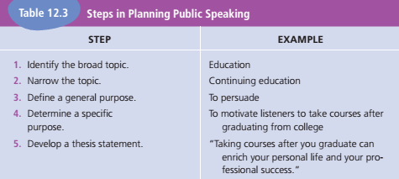
Planning: Step by Step
Cengage Learning

Slide 10
Demographic Audience Analysis
Identifies general features common to a group of listeners
Demographic data is used for
Adaptation
Making connections
Guarding against stereotypes
Making inferences
Determining what and whom listeners may find credible

Slide 11
Situational Audience Analysis
Discover what listeners already know and believe about a topic, speaker, and occasion
Listeners’ orientation toward
Topic
Speaker
Speaking occasion

Slide 12
Digital Media and Planning Public Speaking
Broad online search engines can provide general information
Evaluate information from online sources critically
Is website signed?
Is author qualified?
Is information current?
Is information trustworthy?

Slide 13
Textbook WebLinks
12.1: Idea Generator
Old Dominion University
12.2: Cmap Tools
This site features a software program that helps you prepare concept maps so you can map your ideas.
12.3: The People & the Press
Sponsored by the Pew Charitable Trusts
12.4: Myths About Public Speaking

Slide 14
Websites
Using Humor in Presentations
Toastmasters International
Includes free resources and listings of Toastmasters clubs in your area
American Rhetoric
Includes full text, audio, and video files of the top 100 speeches in the twentieth century

Slide 15

Chapter 16
Researching
and Developing Support
for Public Speeches

Slide 16
Conducting Research
Online research
Search engines
Verifying sources
Library research
Databases and search engines
Reference works
Yuri Arcurs/Dreamstime.com

Slide 17
Interviews
Interviews allow you to…
Gather information
Check accuracy
Understand others’ perspectives

Slide 18
Surveys
Useful in two situations
Lack of published research
To learn about your audience’s knowledge and attitudes regarding your topic
Follow guidelines to create survey
Review Table 13.1 (“Guidelines for Constructing Surveys”) in textbook

Slide 19
Using Evidence to Support Ideas
Evidence
Material used to support claims a speaker makes
Functions of evidence
Makes ideas more clear, compelling, and interesting
Fortifies a speaker’s opinions
Heightens a speaker’s credibility

Slide 20
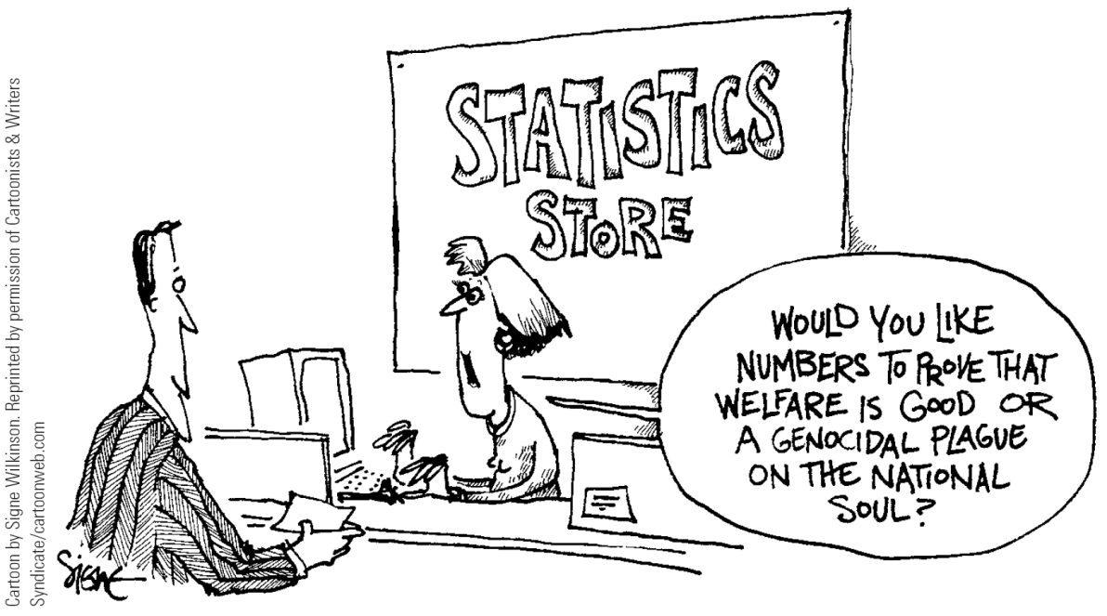
Statistics
Numbers that summarize many individual cases or demonstrate relationships between phenomena
Cartoon by Signe Wilkinson. Reprinted by permission of Cartoonists & Writers Syndicate/cartoonweb.com

Slide 21
When Using Statistics
Limit the number used in a speech
Round off numbers
Use statistics that are timely
Make statistics meaningful and interesting to listeners

Slide 22
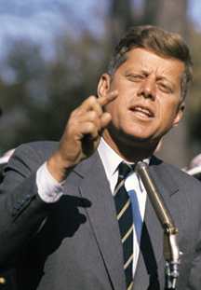
Examples
Undetailed
Detailed
Hypothetical
Diamond Images/Getty Images

Slide 23
Comparisons
Similes
Explicit or direct comparisons (like or as)
“A teacher is like a guide.”
Metaphors
Implicit comparisons that suggest likeness between two things that have something in common
“Love is a rose.”

Slide 24
Quotations
Exact citations of statements made by others
Ethical and effective quotations meet three criteria
Listeners know and respect the source
Halo effect
Accuracy
Unbiased source

Slide 25
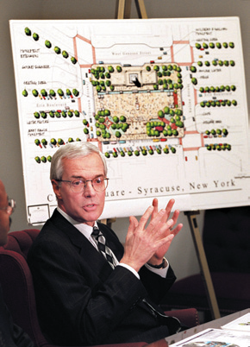
Visual Aids
To reinforce ideas or present information
Types of visual aids
Charts
Graphs
Photographs
Transparences
Computer graphics
Physical objects
Syracuse Newspapers/Dick Blume/The Image Works

Slide 26
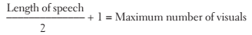
Visual Aid Guidelines
Large and clear
Simple and uncluttered
Safe and nondistracting
Avoid visual overload

Slide 27
Visual Aid Guidelines (cont’d)
Mechanical guidelines
Remove or cover visual aid before and after use
Maintain visual contact with the listeners

Slide 28
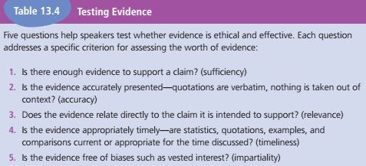
Testing Evidence
Cengage Learning

Slide 29
Digital Media and Researching and Developing Speeches
Online search engines and databases provide information
Interviews and surveys may be conducted using digital media
Digital media can be used to create and present visual aids

Slide 30
Textbook WebLinks
13.1 Evaluating Web Resources
13.2 The “I Have a Dream” speech
From Dr. Martin Luther King, 8/23/1963
13.3: What is Plagiarism?
Georgetown University
13.4: PowerPoint in the Classroom

Slide 31
Websites
About.com: Quotations
U.S. Census Bureau
Federal Statistics
The Gallup Poll
Free Online Encyclopedia
Newspapers.comUsing Visual Aids Effectively
University of Hawai'i Maui Community College
The Total Communicator
E-zine posted by the Executive Communication Group

Slide 32

Chapter 17
Organizing and Presenting Public Speeches

Slide 33

Organizing Speeches
Organizing oral communication differs from organizing written communication in three ways:
Requires more explicit organization
Benefits from greater redundancy
Should rely on less complex sentence structures
Jacobs Stock Photography/Digital Vision/Getty Images

Slide 34
Outlining Speeches
Working outline
Just for the speaker, multiple drafts
Formal outline
Includes all main points, supporting materials, and transitions (Table 14.1)
Key word outline
Designed to trigger a speaker’s memory of each point

Slide 35
Organizing the Body
Temporal pattern
time, chronological relationships
Spatial pattern
physical relationships
Topical pattern
categories, classes, areas of discussion
Star pattern
flexible arrangement of topics

Slide 36
Organizing the Body (cont’d)
Comparative pattern
compares two or more objects, people, situations, events, or other phenomena
Problem-solution pattern
effective for persuasive speeches
order can be inverted (Solution-Problem)
Cause-effect and effect-cause patterns
argues a direct relationship between two things
difficult to prove direct causation

Slide 37
Designing the Introduction
Capture listeners’ attention
Dramatic piece of evidence
Quotation
Striking visual aid
Questions that invite audience involvement
Current events or experiences
Direct experience
Humor

Slide 38

Designing the Introduction (cont’d)
Present a clear thesis statement
Build credibility
Preview the body (major points)
Image Source RF/Cadalpe/Getty Images

Slide 39
Crafting the Conclusion
Concisely summarize content
Provide a final memorable thought

Slide 40
Transitions
Words, sentences, or nonverbal cues that connect ideas and main points in a speech

Slide 41
Building Speaking Confidence
Communication apprehensions: some degree of anxiety about communicating
Natural and helpful; increases energy
Limit its interference with effectiveness

Slide 42
Causes of Apprehension
Chronic vs. situational
Factors
Unfamiliar audience/people
Unfamiliar situation
Being in the spotlight
Being evaluated
Past failures

Slide 43
Managing Apprehension
Understanding some anxiety is natural and often helpful
Using positive self-talk
Engaging in positive visualization

Slide 44
Oral Style
Visual, vocal, and verbal communication with listeners
Qualities of effective oral communication
Informal
Personal
Immediate and active

Slide 45
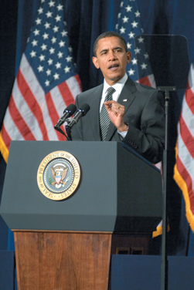
Styles of Delivery
Impromptu
Extemporaneous
Manuscript
Memorized
Christopher Halloran/Shutterstock.com

Slide 46
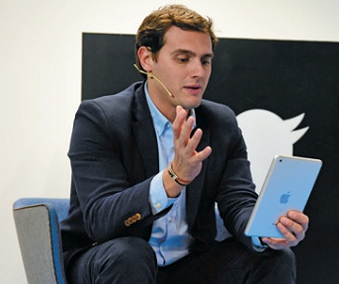
Practice!
Practice
Practice
Practice
AFP/Getty Images

Slide 47
Textbook WebLinks
14.1: “How To Conquer Public Speaking Fear”
Written by Dr. Morton C. Orman
14.2: Presentation Tips for Public Speaking

Slide 48
Websites
Toastmasters International
Includes free resources and listings of Toastmasters clubs in your area
American Rhetoric
Includes full text, audio, and video files of the top 100 speeches in the twentieth century
Speaking-Tips.com
Executive Communications Group
Articles and reprints on communication and presentation skills

